Slide 1

EUROSTAT NUTS-2 REGIONAL ANALYSIS
Do Higher Wages
Mean a Better Life?
Exploring Regional Well-Being Across Europe
91 Regions · 27 EU States · 5 Well-Being Indicators
Modul University & MCC AI Workshop · May 2026

Slide 2




THE QUESTION
Why Wages Alone Don't Tell the Story
A worker in Hamburg earns roughly ten times more than one in Severozapaden, Bulgaria. But does earning more automatically translate into living better?
Purchasing Power
Health Outcomes
Job Access
€15k in Prague may buy as much as €25k in Lisbon
Campania matches Berlin on life expectancy at half the GDP
Brussels: €61k wages but only 66.5% employment

Slide 3


FRAMEWORK
Five Dimensions of Well-Being
GDP per Capita (PPS)
Purchasing-power adjusted
Compensation / Employee
Nominal wages in €
Unemployment Rate
Share of labour force
Life Expectancy
At birth, both sexes
Employment Rate (20-64)
Share actually in work
Data: Eurostat datasets nama_10r_2gdp, nama_10r_2lp10, tgs00010, demo_r_mlifexp · 2022–2023

Slide 4
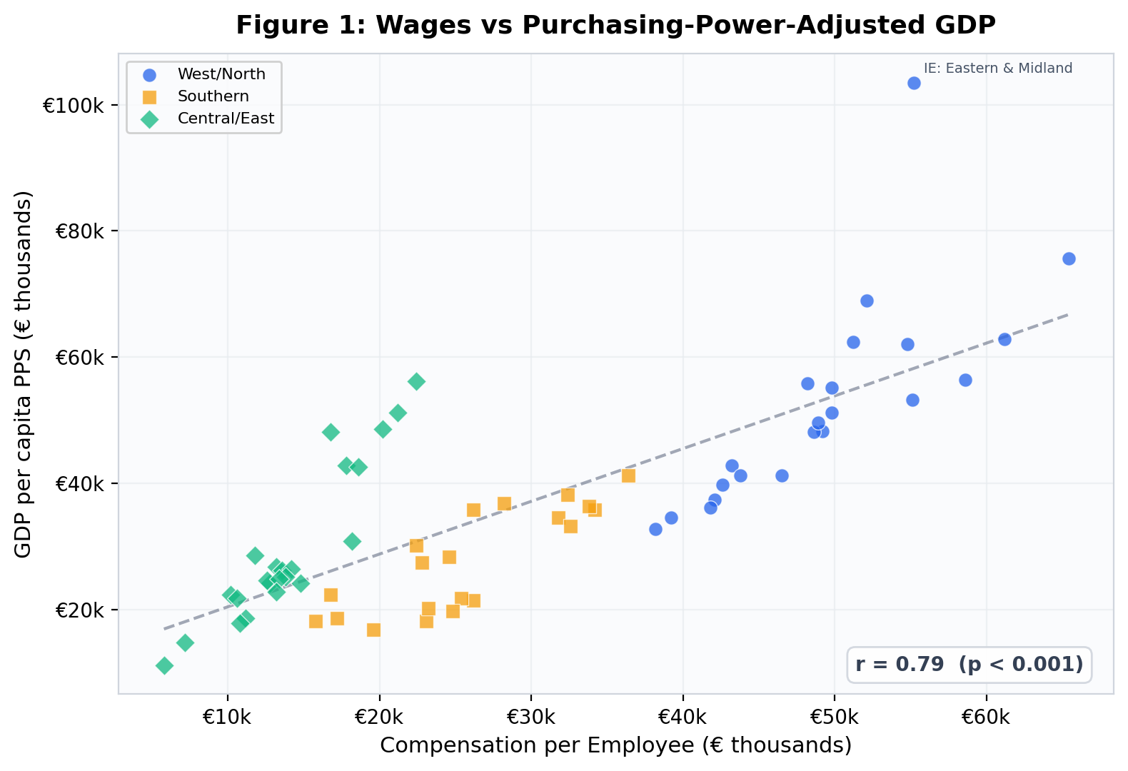
FINDING 1
r = 0.80
Wages Track GDP — With Exceptions
Key Insight
Strong overall link, but Central/Eastern regions show higher purchasing power relative to nominal wages.
Ireland's Eastern region is a dramatic outlier — GDP inflated by multinational profits, not household prosperity.

Slide 5
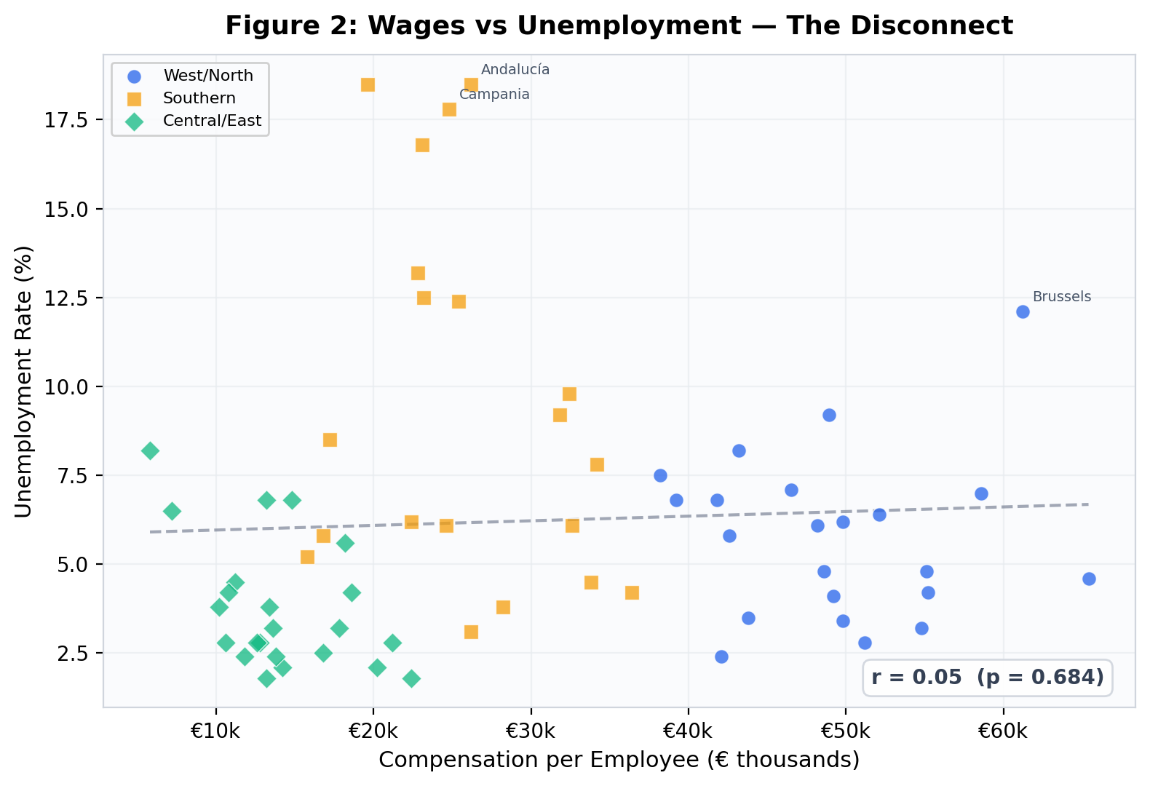
FINDING 2
r = −0.10
The Wage–Unemployment Disconnect
Most Striking Finding
Near-zero correlation! High wages do not guarantee low unemployment.
Andalucía (18.5%), Campania (17.8%): moderate wages but massive joblessness.
"Who has access to those wages?" matters more than how high they are.

Slide 6

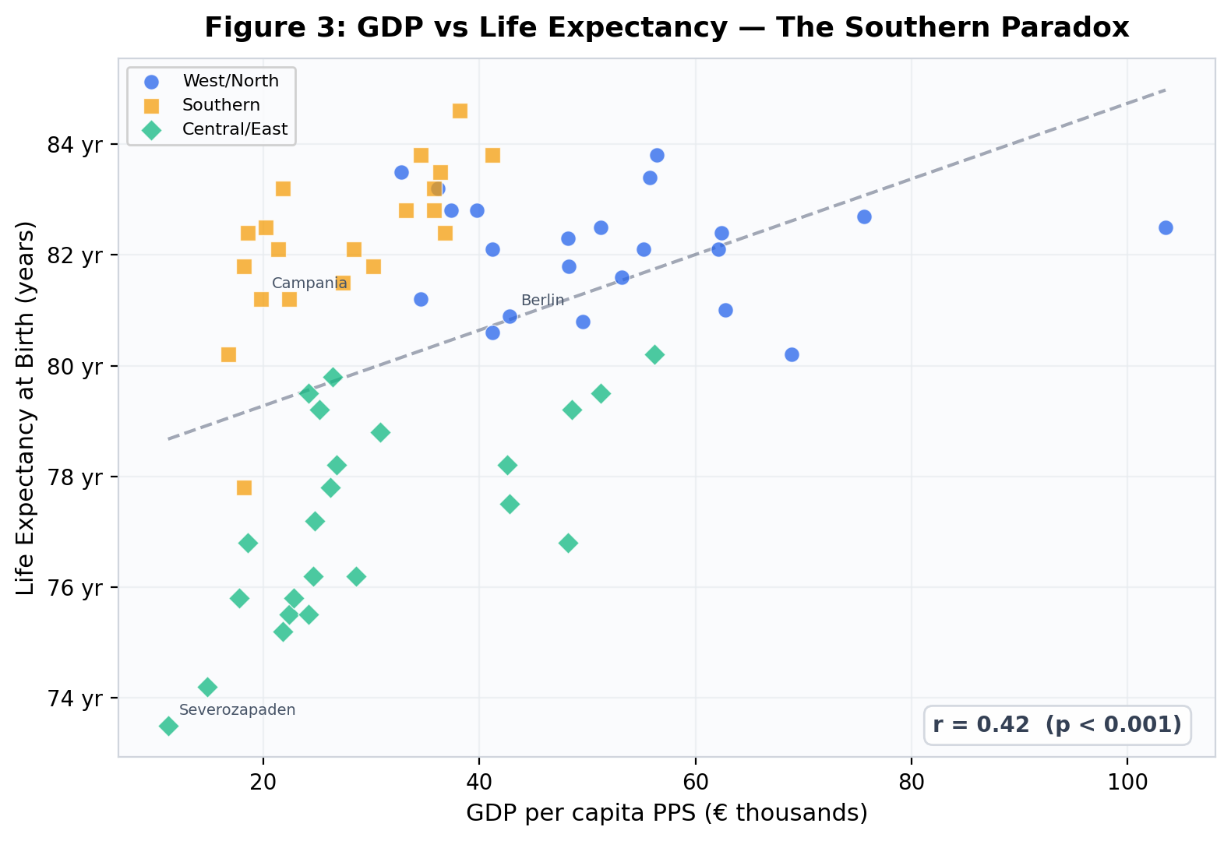
FINDING 3
r = 0.48
The Southern Paradox
Southern Paradox
Southern regions achieve 81–85 yr life expectancy on modest incomes.
Campania: €19,800 GDP → 81.2 yr
Berlin: €42,800 GDP → 80.9 yr
Mediterranean diet, climate, social cohesion, and universal healthcare generate health outcomes that richer regions struggle to match.

Slide 7

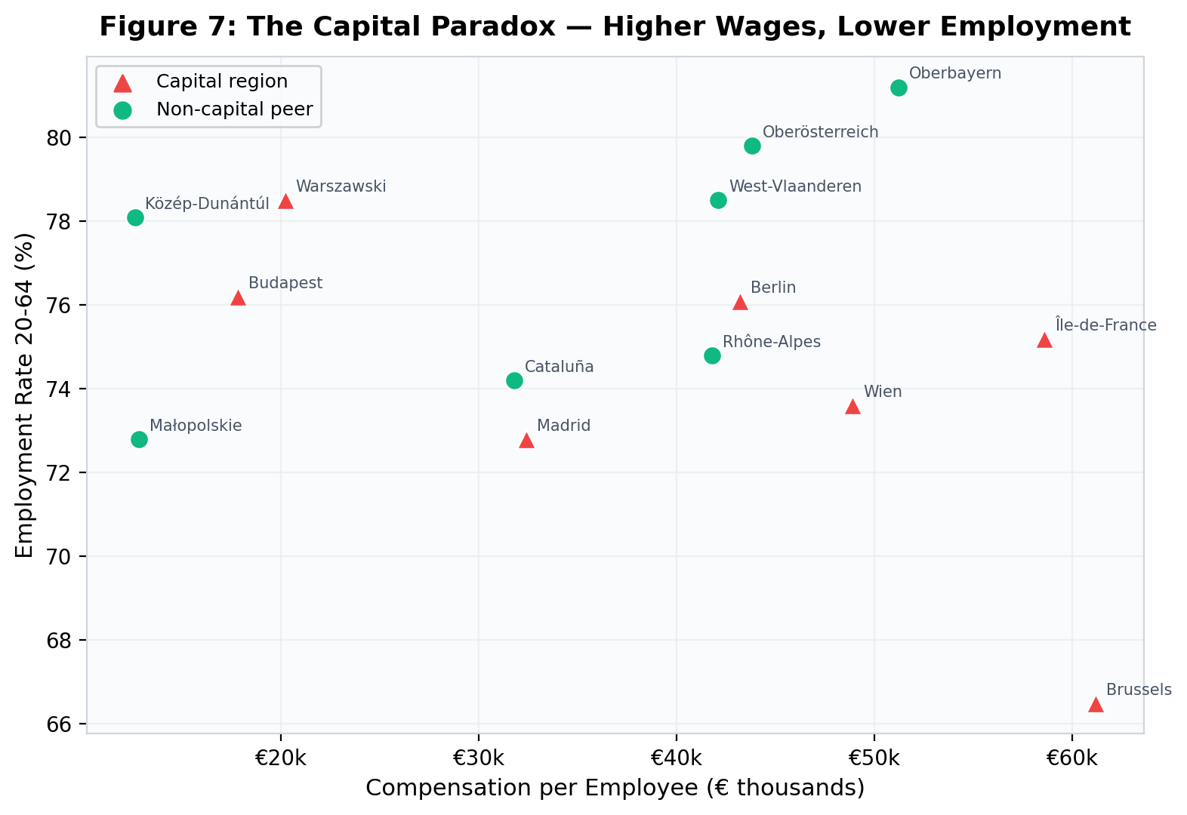
FINDING 4
The Capital Paradox
Higher Wages, Lower Employment
Brussels: €61,200 wages
but only 66.5% employment
12pp below West Flanders (78.5%)
Capitals attract HQ jobs but concentrate structural unemployment invisible in averages.

Slide 8
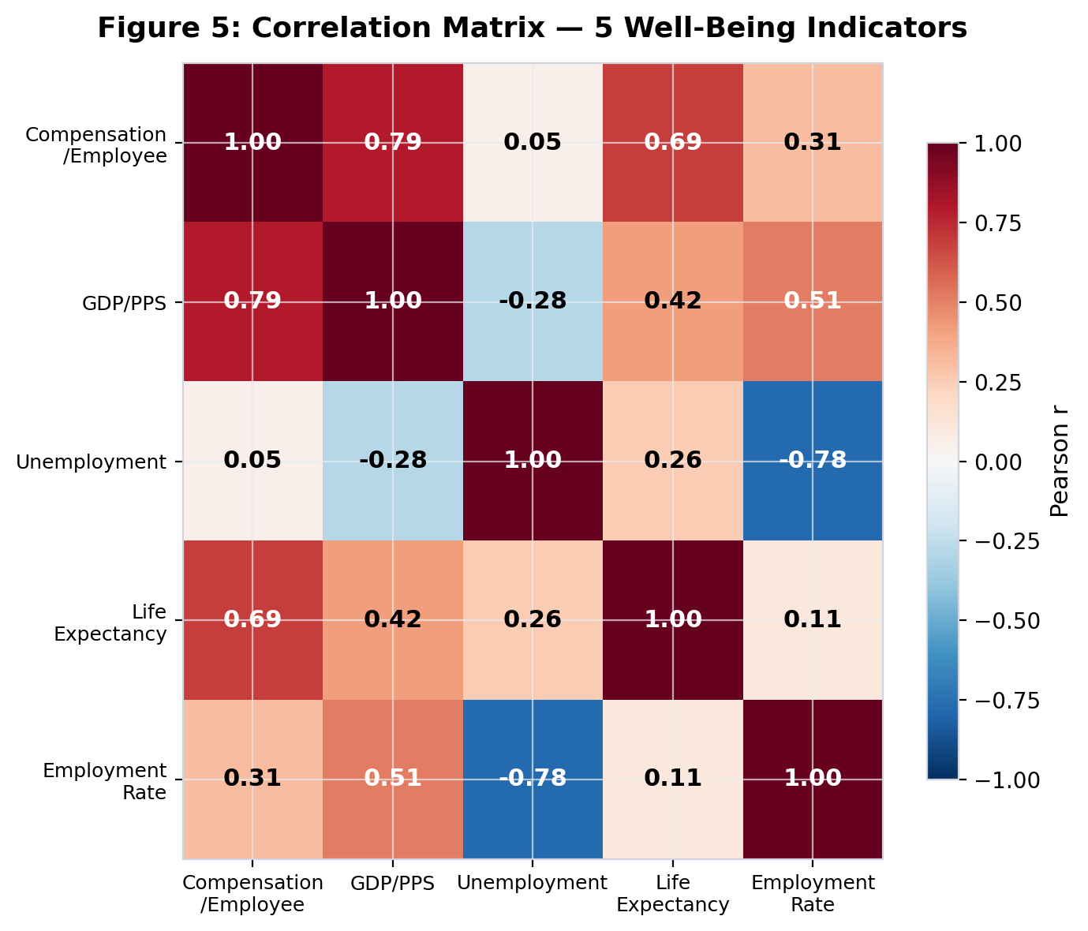
CORRELATION STRUCTURE
How the Five Indicators Relate
+0.80
Wages → GDP
+0.67
Wages → Life Exp.
+0.43
Wages → Emp. Rate
−0.10
Wages → Unemp.
−0.80
Unemp. → Emp.

Slide 9

REGIONAL GROUPS
No Group Wins Everywhere
West / North
Southern
Central / East
22 regions
20 regions
23 regions
Avg Wage
€45,808
Avg Wage
€25,363
Avg Wage
€13,188
Unemployment
6.0%
Unemployment
9.5%
Unemployment
4.5%
Life Exp.
81.8 yr
Life Exp.
82.1 yr
Life Exp.
77.1 yr
C/E has lowest wages but lowest unemployment. South has highest unemployment but highest life expectancy.

Slide 10
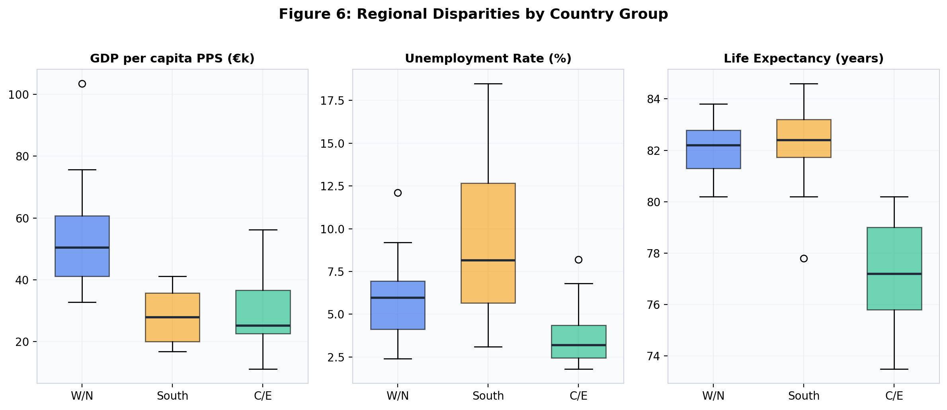
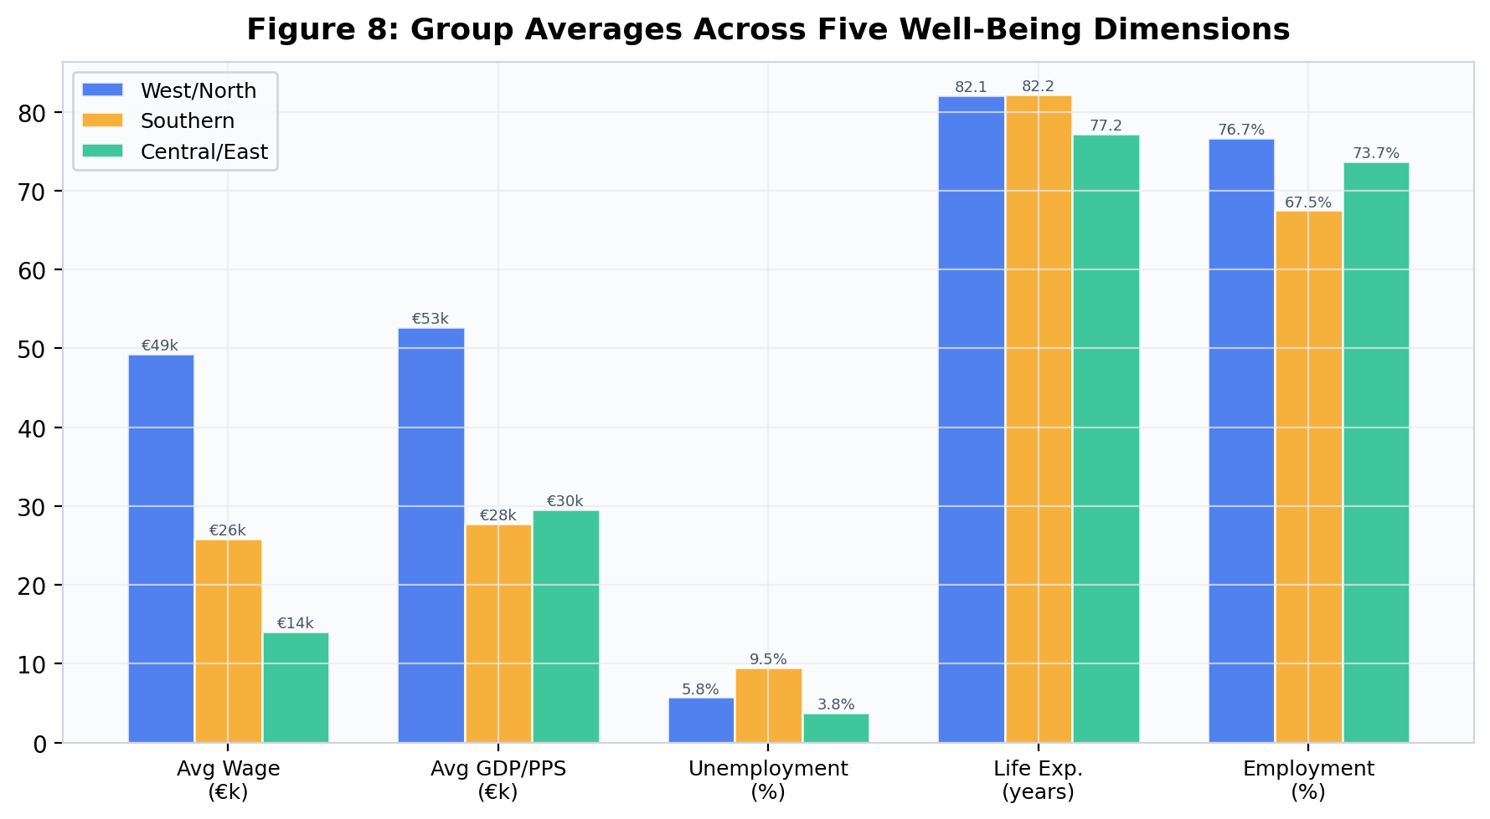
DISTRIBUTIONS
Variation Within and Between Groups
Southern Europe shows the widest spread on unemployment (3–18%) while achieving the tightest clustering on life expectancy (80–85 years). Central/Eastern regions cluster tightly on unemployment but diverge sharply on GDP.

Slide 11
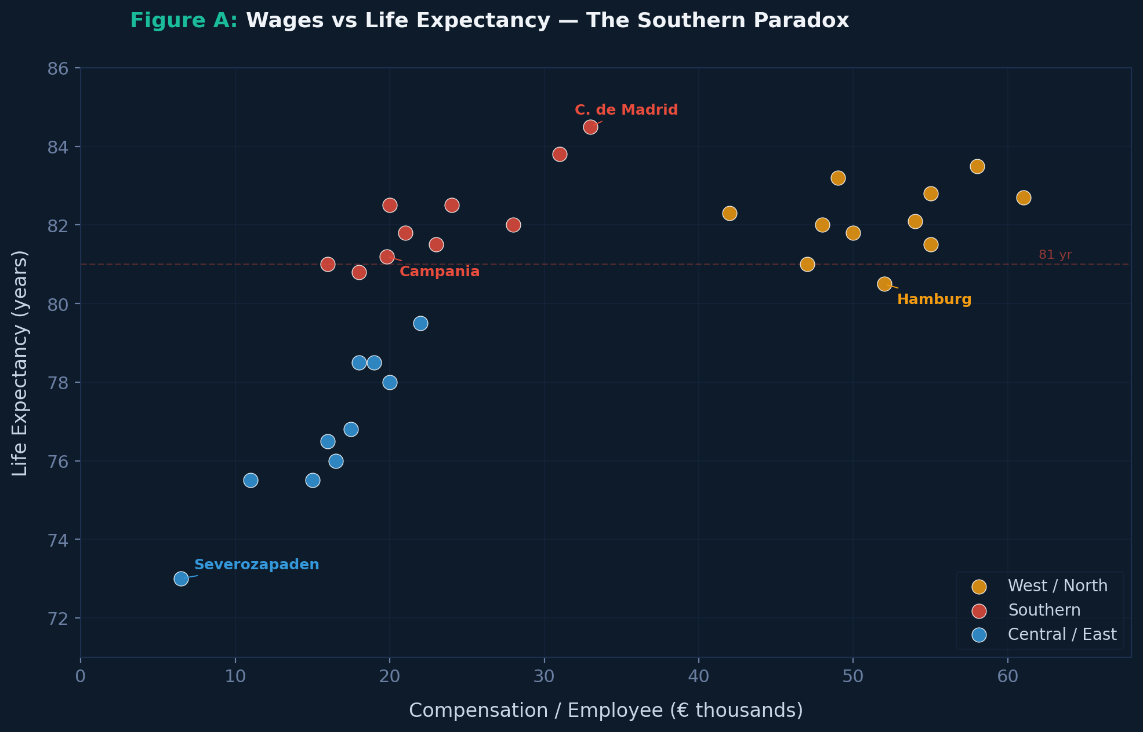
ADDITIONAL CHART
r = 0.67
Wages vs Life Expectancy
Key Insight
Southern regions cluster at high life expectancy despite low wages, matching wealthy Western regions.
Campania: €19.8k → 81.2 yr
Hamburg: €52k → 80.5 yr
Central/Eastern regions show a clear life expectancy penalty, but the gap narrows at higher wage levels.

Slide 12
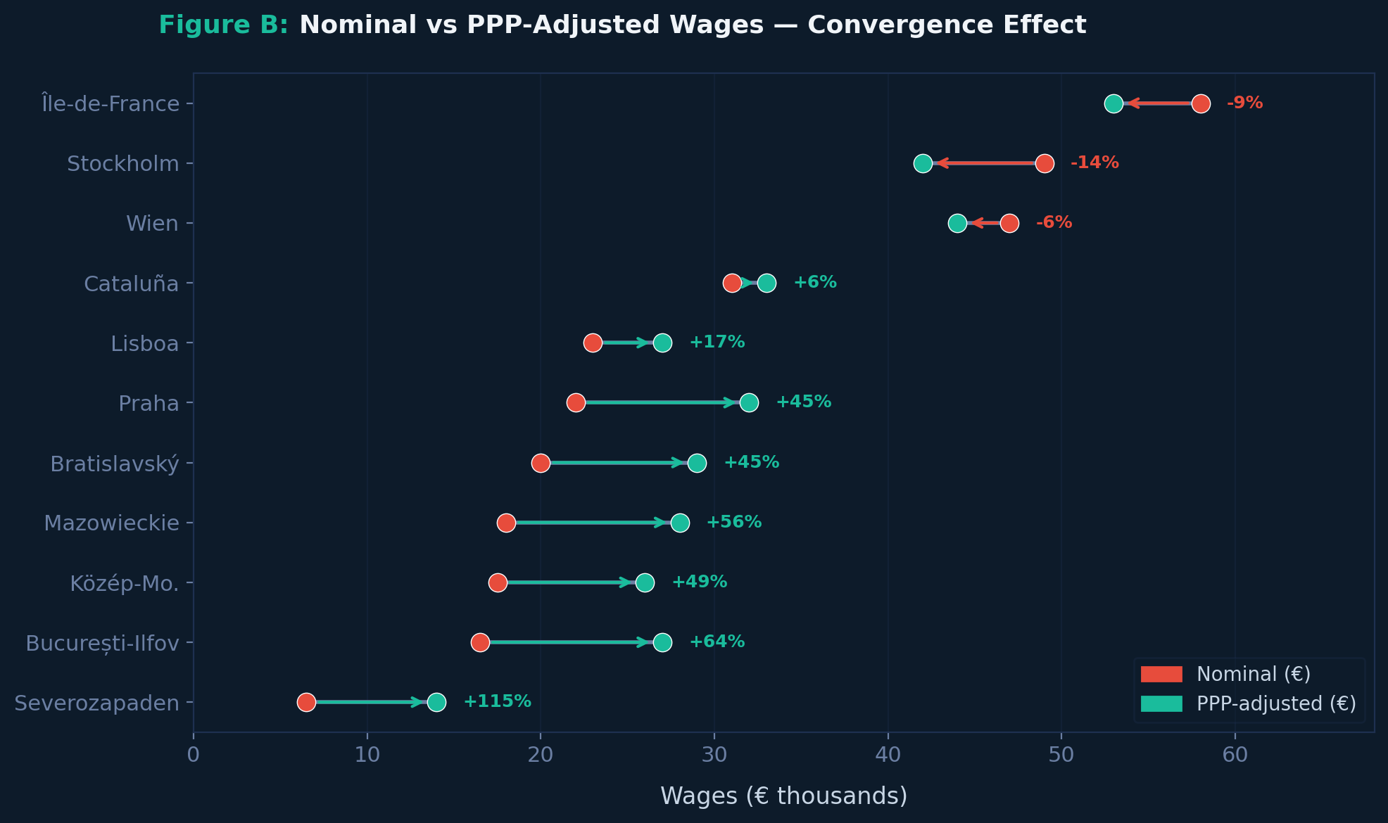
ADDITIONAL CHART
PPP Gap
Nominal vs PPP-Adjusted Wages
Convergence Effect
After adjusting for purchasing power, the East-West wage gap shrinks dramatically.
București: €16.5k → €27k (+64%)
Stockholm: €49k → €42k (−14%)
Central/Eastern convergence is further along than nominal comparisons suggest. PPP adjustment reshapes the map of European well-being.

Slide 13
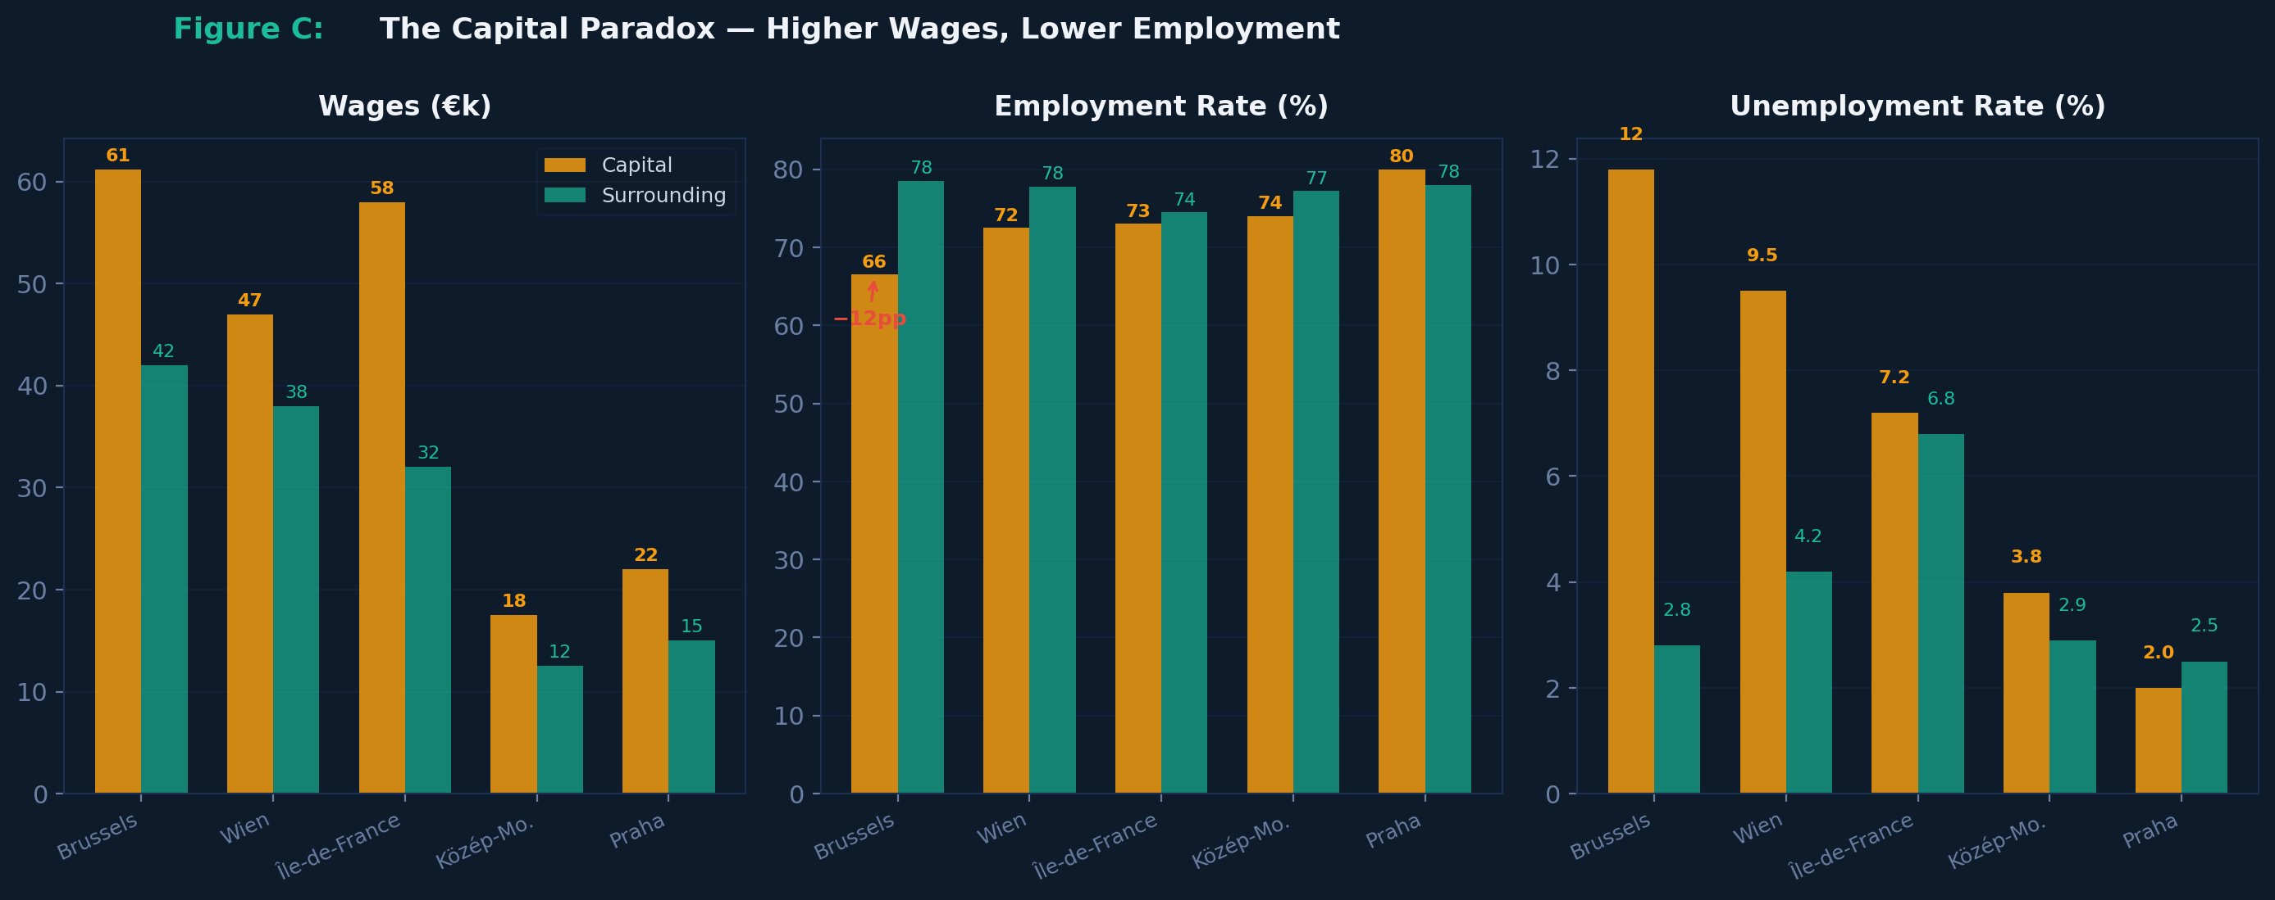
ADDITIONAL CHART
−12pp
The Capital Paradox Visualised
Capital vs Surrounding
Capital regions earn far more but often employ fewer people than surrounding areas.
Brussels: €61.2k wages, 66.5% emp.
W. Flanders: €42k wages, 78.5% emp.
Capitals attract HQ jobs but concentrate structural unemployment invisible in wage averages.

Slide 14

AI-ASSISTED ANALYSIS
How AI Accelerated This Research
01
Framing
Identified Eurostat datasets at NUTS-2, designed multi-dimensional framework
02
Exploration
Generated variable-pair visualisations, detected wage–unemployment disconnect
03
Interpretation
Connected patterns to economics: Southern Paradox, Capital Paradox, PPP effects
04
Visualisation
Designed charts, regional comparisons, narrative structure
05
Document Creation
Produced formatted report, presentation, and interactive dashboard
AI accelerated exploration and iteration, but economic reasoning and judgment on defensible interpretations remained essential human contributions.

Slide 15
CONCLUSION
Three Patterns That Challenge the Assumption
01
The Southern Paradox
Modest incomes, world-class health outcomes. Mediterranean diet, climate, and universal healthcare outweigh GDP above a threshold.
02
The Capital Paradox
Aggregate wealth conceals deep inequality. The highest-wage regions often have the lowest employment participation.
03
Purchasing Power Convergence
Central/Eastern convergence is further along than nominal comparisons suggest. PPP adjustment reshapes the map.
A better life depends not only on how much people earn, but on how much economic security and quality of life those wages actually create.

